Slide 1

CSC384 TUT9101

Slide 2
CSC384:Intro to artificial intelligence
TUT9101 Thursdays 9:10-10AM

Slide 3
CSC384 Tutorial 4: CSP
A2 office hours
Midterm and Midterm office hours
Exercise 1
Discuss
Degree Heuristic
MRV Heuristic
Exercise 2 break out groups
Discuss
Questions?
Toso vote

Slide 4
A2 office hours tomorrow
Thursday, February 25, 2020
At 7:00 Pm - 8:00 Pm EST
On "BB Collaborate"
Hosted by Daniel Razavi

Slide 5
Midterm-25%
Tuesday, March 2nd
9AM EST
Details will be posted on piazza

Slide 6
Midterm office hours next Monday
Monday, March 1, 2020
At 7:00 Pm - 8:00 Pm EST
On "BB Collaborate"
Hosted by Kristina Todic

Slide 7
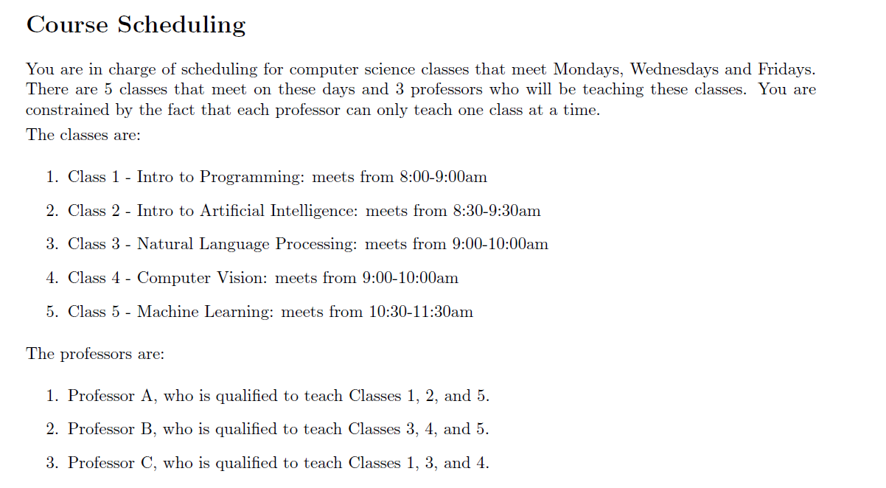

Slide 8
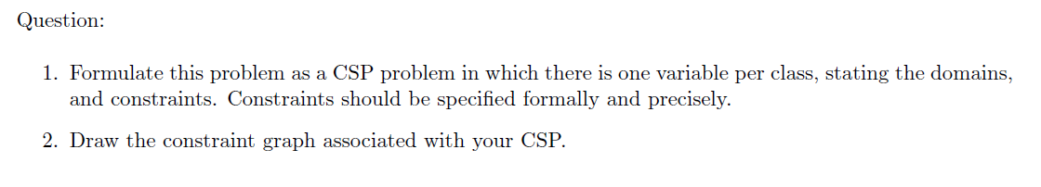

Slide 9
Let’s discuss!

Slide 10
Solution
Domains:
C1 = {A,C}
C2 = {A}
C3 = {B,C}
C4 = {B,C}
C5 = {A,B}
Constraints:
C1 != C2
C2 != C3
C2 != C4
C3 != C4

Slide 11
Let’s draw the graph!

Slide 12
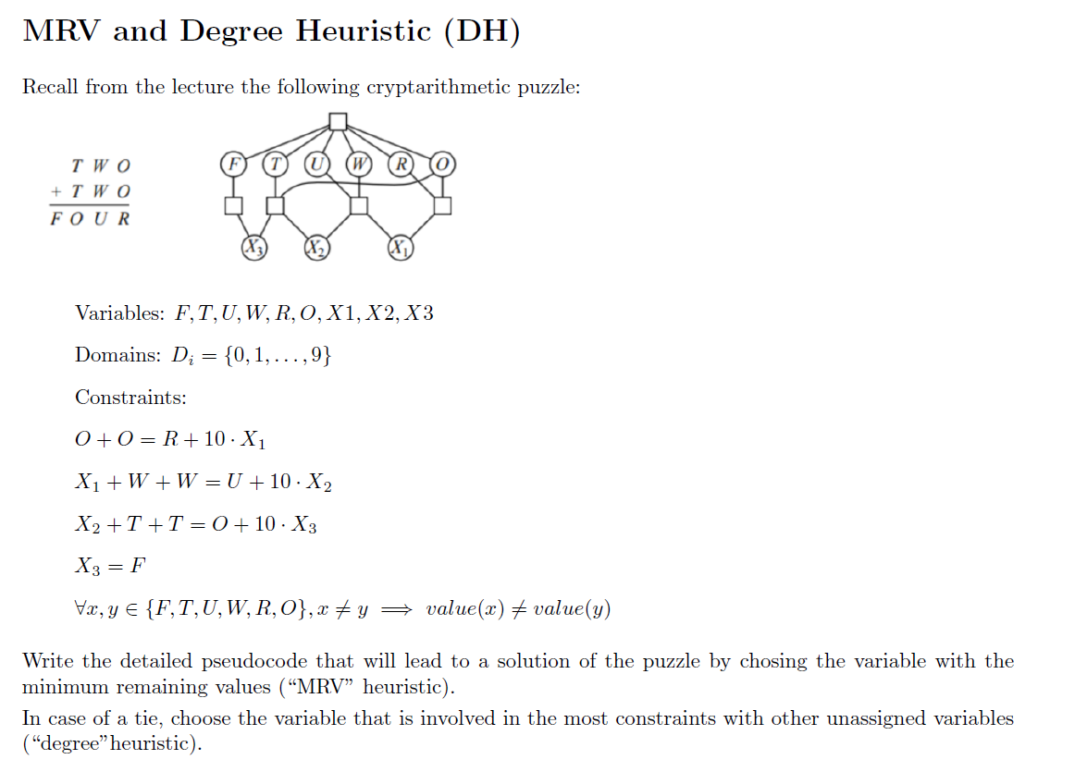

Slide 13
Degree Heuristic
Select variable that is involved in the largest number of constraints on other unassigned variables

Slide 14
Minimum Remaining Values Heuristic
Always branch on a variable with the smallest remaining values (smallest CurDom).
If a variable has only one value left, that value is forced, so we should propagate its consequences immediately.
This heuristic tends to produce skinny trees at the top. This means that more variables can be instantiated with fewer nodes searched, and thus more constraint propagation/DWO failures occur with less work.

Slide 15
Solution-degree heuristic
degree(F) = 5 + 1 = 6
degree(T) = 5 + 3 = 8
degree(U) = 5 + 3 = 8
degree(R) = 5 + 2 = 7
degree(W) = 5 + 3 = 8
degree(O) = 5 + 2 + 3 = 10
degree(X3) = 3 + 1 = 4
degree(X1) = 3 + 2 = 5
degree(X2) = 3 + 3 = 6

Slide 16
Pseudocode
Assignment = {}
Choose next variable:
MRV, all ties
Break a tie with degree.
Proposal for a definition of the degree of variable V:
sum = 0
for all square boxes B connected to V in the constraint graph:
sum += number of edges of B - 1
degree(f) = 5 + 1 = 6
degree(x2) = 3 + 3 = 6
degree(w) = 5 + 3 = 8
degree(o) = 5 + 2 + 3 = 10
...

Slide 17
Pseudocode cont.
So, e.g., if o is in X constraints with variable V, we count
all X of them. Makes sense - each different constraint may
rule out additional values.
By degree, we choose o.
Now, we want to order the values (least constraining values). We cannot compute this quickly in our heads.
Needed:
sums = {0:0,1:0,2:0,3:0,4:0,5:0,6:0,7:0,8:0,9:0}
For i from 0 to 9:
plug "o=i" into the constraint formulas
For each neighbor "N" of "o" in the constraint graph:
sums[i] += the number of values remaining for "N"
Return the i such that sums[i] is the maximum value in sums

Slide 18
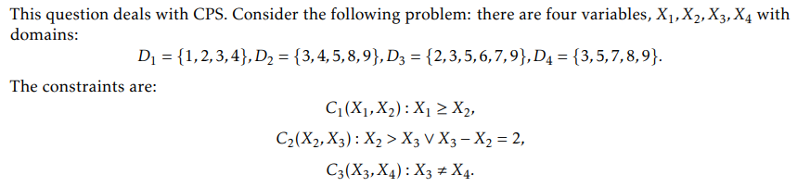
CPS question from midterm

Slide 19
Let’s draw constraint graph

Slide 20
Is the constraint graph arc-consistent ? If yes, find a solution. If not, compute the arc-consistent graph.

Slide 21
Any questions?

Slide 22


Pls consider voting for Toso for America’s favourite pet!
I will put link in chat if you would like to vote!

